Slide 1
Pegpop

Slide 2
Colour Scheme
#70B8FF
#78CACA
#85FFAD

Slide 3


Peg Colour

Slide 4


Peg With Colour

Slide 5
Colour Test

Slide 6
Colour Test

Slide 7
Fonts
Create profile
Create profile
Create profile
Create profile
Create profile
Create profile
Create profile
Create profile
Create profile
Create profile
Create profile
Create profile
Create profile
Create profile
Create profile
Create profile

Slide 8
Final Font Colour
For Username and other text
Create profile
Courier New
Create profile

Slide 9

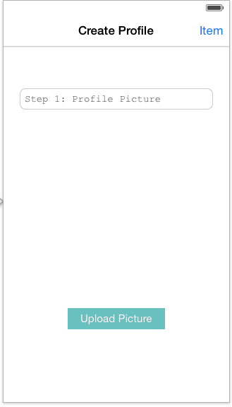
App Design - New User
Next arrow
Automatically Get FB profile picture
Rounded button

Slide 10
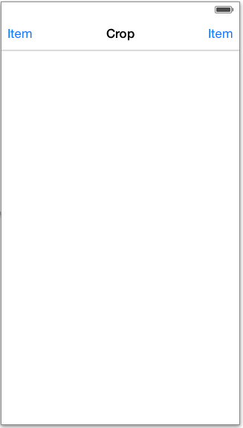
Upload Picture Clicked
Alert View with the following option appears
Photo Gallery
Camera
Instagram
Facebook
Shrinks/enlarges picture

Slide 11
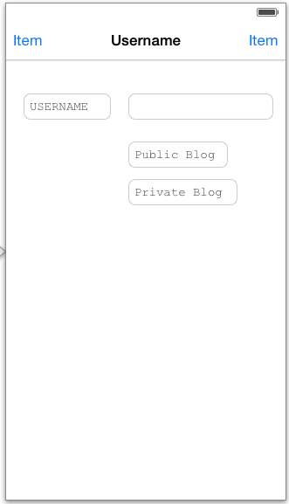
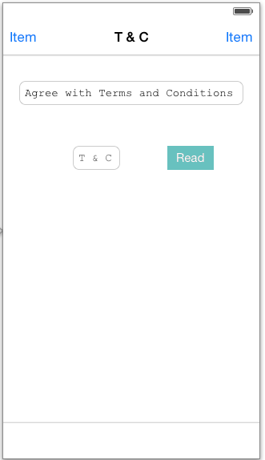
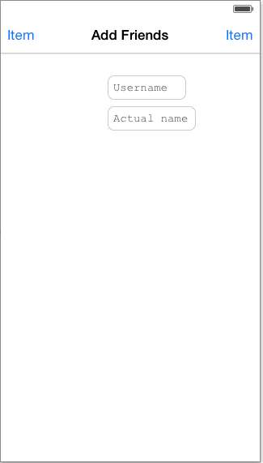

Finding travellers within
FB Friends
+
A
A. Click photo to add friend
+ Add
Pending
Click again to cancel request

Slide 12
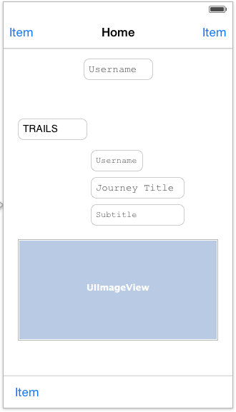
Home
Key
A Search
Click and brings up 3 most recent searches. When typing starts will bring up most recent and then suggestions will pop up
B Settings bar
C Own post
D Leads to their profile
E Whole blog post
F Goes to the particular post
G Home
H “What’s hot”
I Add
J Map
K My planned trail (“Wish List”)
A
B
C
C
D
E
F
Scroll down refreshes page for new feed
F
G
H
I
J
K

Slide 13
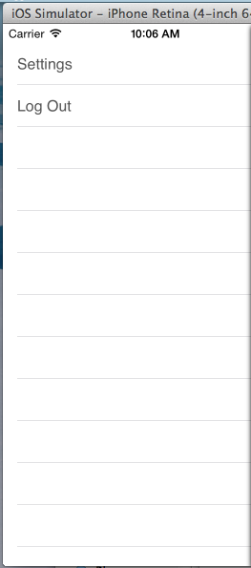
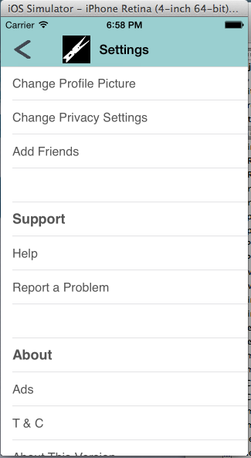
Settings Bar
Settings
Change Profile Picture
Change Privacy Settings
Add Friends
Support
Help
Report a Problem
About
Ads
T & C
About this Version
Account History
Can scroll up & down
Slide out bar

Slide 14
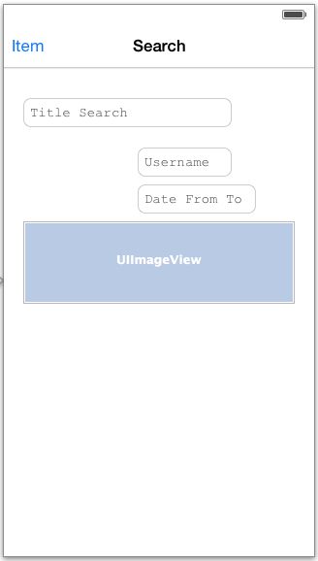
Search Bar
Journey Title Search
Can search for:
Location
Pegged words
Users
Swipe right
Filter table appears
Filter
Date
Popularity
Following
A Takes to user page
A
A
Banner to blog post

Slide 15
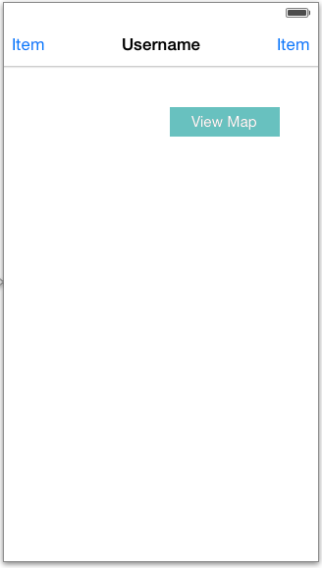
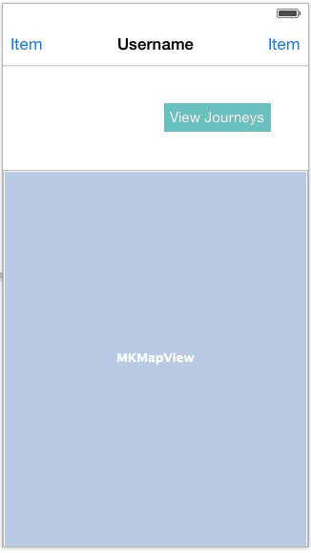


Own Post Page
Journey 1
Auto default of current location.
If current location not enabled,
will default to the last set location
Scroll to see more of the globe

Slide 16
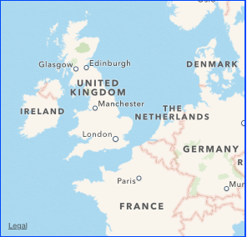
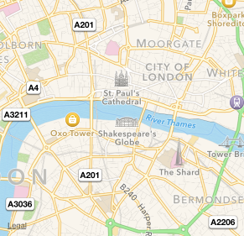
Map View
Click - Main picture of of the sub
blog post appears
Zoom in - double tap/zoom in
motion with fingers
Zoom in - String breaks down
to path to get from A-B
Google Map
Pegs current location and past locations
Location
Sub-Title
Pegged Location

Slide 17
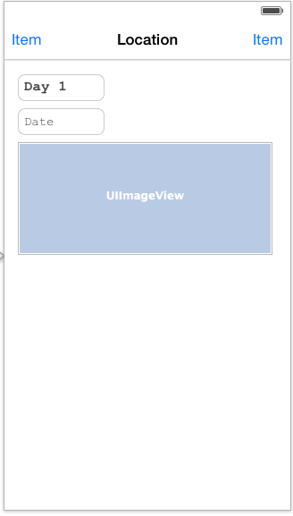
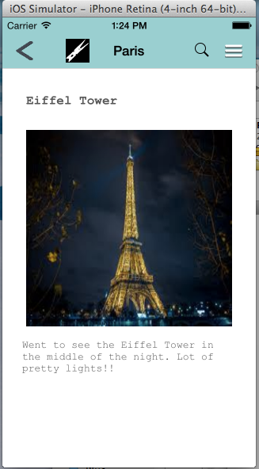
Blog Post
Settings
Edit
Log Out
Setting bar appears
Can have as many text and photos
for each sub title
Click and expands to comments
Other peoples profile blog will be the same layout as above but with no edit rights

Slide 18
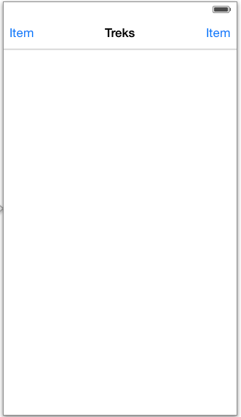
What’s Hot
Username
Algorithm with be mixed with:
Most like in the past 24 hours
Your history in the past x amount
of days
Sub-Title

Slide 19
Edit clicked
If decided to edit existing blog. Can edit:
Subtitle
Photo
Text

Slide 20
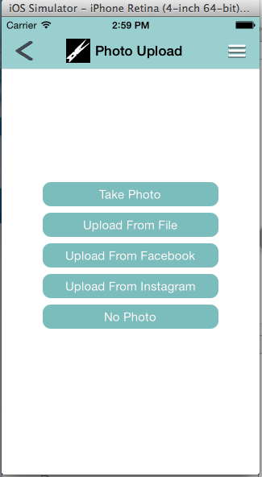
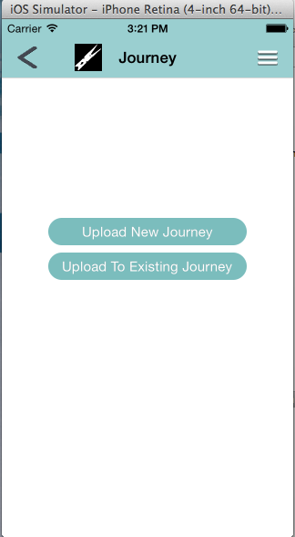
Adding Journey
Change to picture icon?

Slide 21
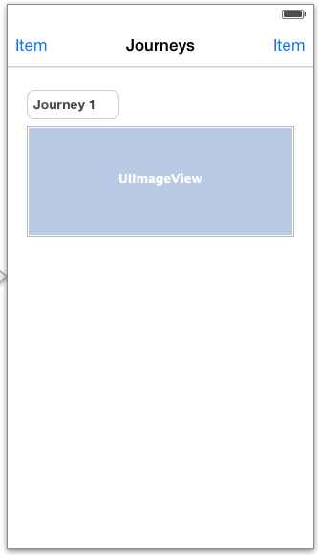
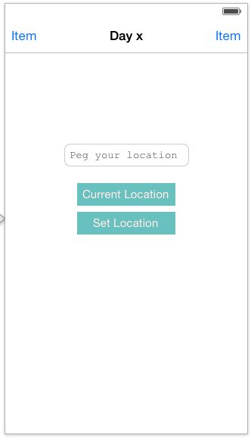
Add To Existing Journey

Slide 22
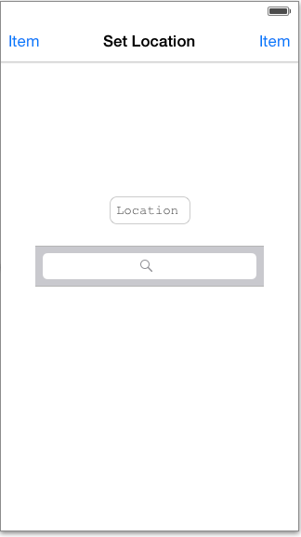
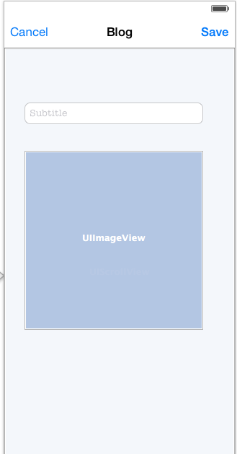
Goes to full day blog
Autoreads
Editable description text field
+
Leads back to photo upload
Crop
Blog page

Slide 23
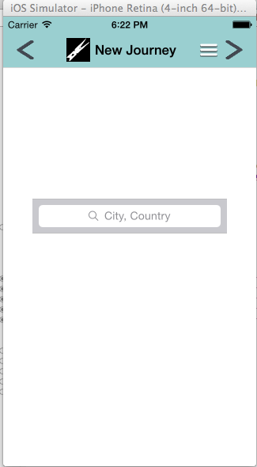
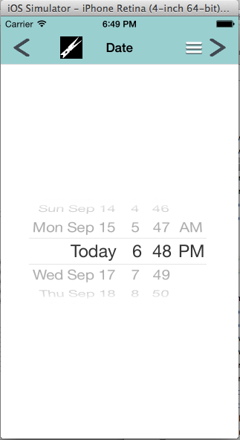
New Journey
Go back to Peg location and start again
Autofill

Slide 24
Things To Consider
Terms and conditions
Setting bar
My planned trails
How to incorporate Day 1, Day 2 etc

